Slide 1



Influences on the diet quality of preschool children: importance of maternal psychological characteristics
Dr Megan Jarman PhD ANutr (Public Health)
MRC Lifecourse Epidemiology Unit
NIHR Southampton Nutrition Biomedical Research Centre
mj@mrc.soton.ac.uk

Slide 2
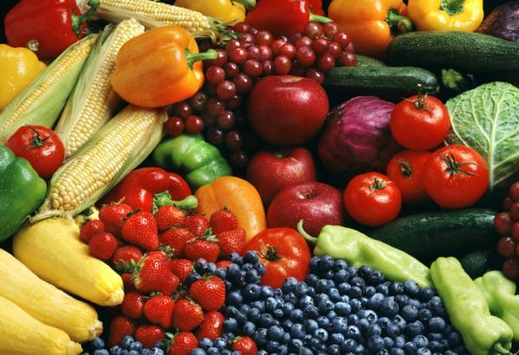
Background
Quality of children’s diet is integral to optimal growth, development and lifelong health
“Poor quality diets are common among children aged 1.5-4.5 years and improving diet quality of preschool children is an important area for investment” (Scientific Advisory Committee on Nutrition)
Maternal, child and home food environment characteristics have been identified as important influences on children’s quality of diet but these are often studied in isolation

Slide 3
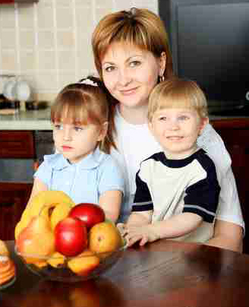
Maternal psychological factors
General control
“I think that what happens in my life is often determined by factors within my control”
General self-efficacy
“I can overcome challenges in my life”
Research question:
Do maternal psychological profiles predict children’s quality of diet?
Self-efficacy for healthy eating
“I can overcome barriers to having a healthy diet”
Food involvement
“I enjoy cooking for others and myself”
Well-being
“I feel cheerful and in good spirits”

Slide 4
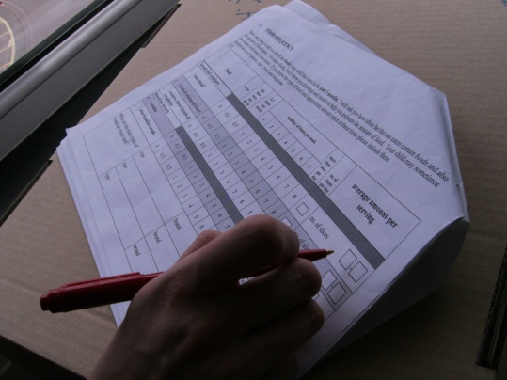
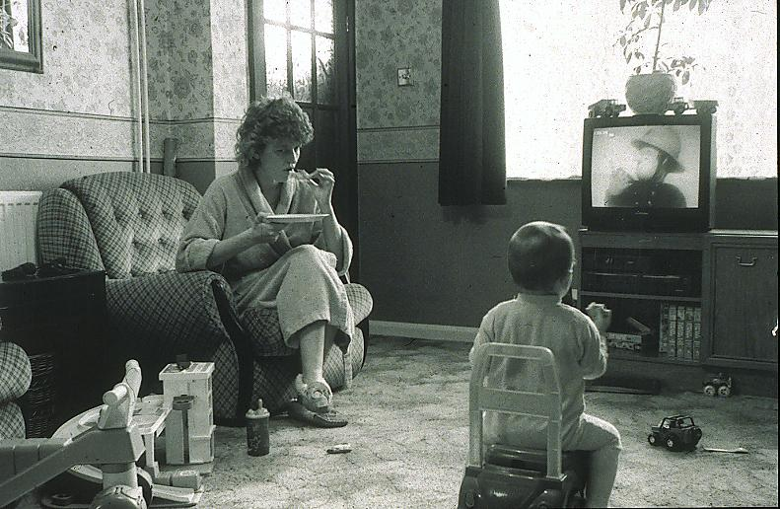
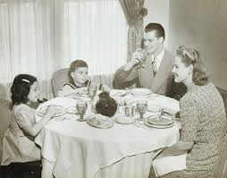
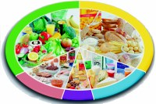
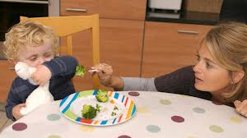

Methods
Mothers taking part in the Southampton Initiative for Health, with a 2-5 year old, were invited to complete a survey
A questionnaire was used to collect information on child’s quality of diet, characteristics and the home and mealtime environment
Information about the mother was available from her participation in the Southampton Initiative for Health

Slide 5
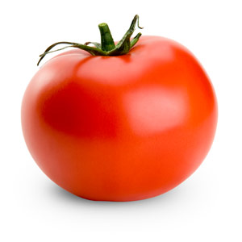
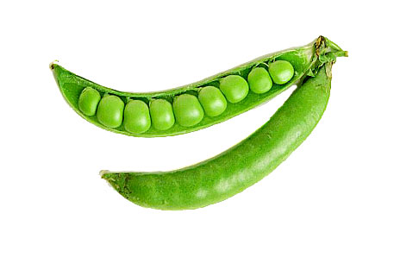



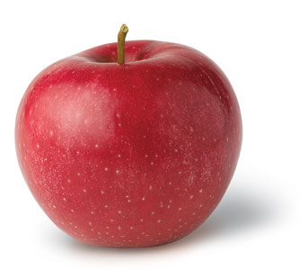
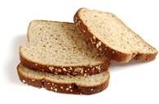
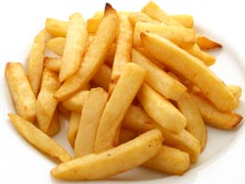

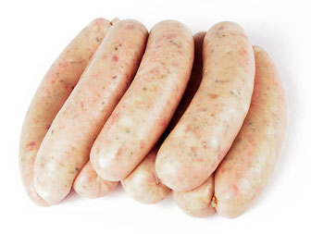
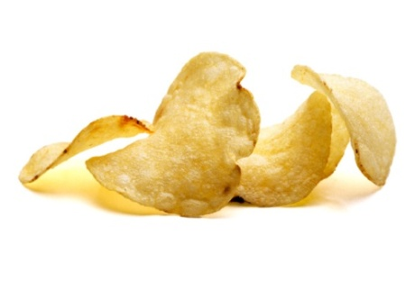
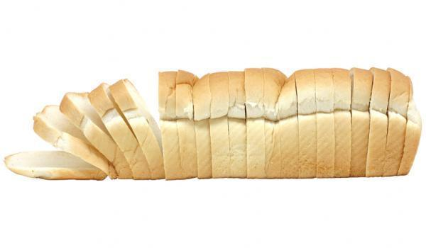
Quality of diet score
Good quality (high score)
Poor quality (low score)

Slide 6
Maternal and child characteristics
N 348
Children characteristics | Mean | SD
Age | 3.3 | 0.9
Gender | N | %
Boys | 177 | 51
Girls | 171 | 49
Number of children in the house | N | %
1 | 110 | 32
2 | 163 | 47
3 | 46 | 13
4+ | 29 | 8
Maternal characteristics | Mean | SD
Age | 33.1 | 5.4
Educational level | N | %
≤ GCSE | 134 | 39
>GCSE | 214 | 61

Slide 7


Statistical analysis
A correlation matrix showed that the maternal psychological factors, general control, self-efficacy, self-efficacy for healthy eating, well-being and food involvement were correlated
A cluster analysis was performed on the psychological factors
Cluster analysis is the task of grouping a set of observations such that those in the same group (cluster) are more similar to each other than to those in the other groups.

Slide 8
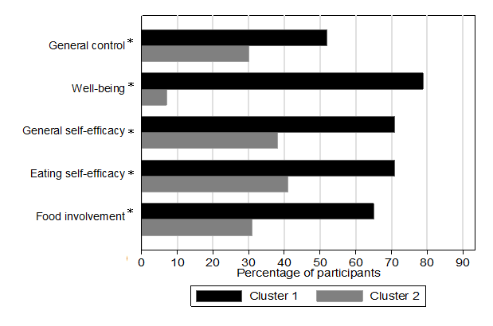
Results 1
Percentage of mothers with scores above the median for psychological factors according to cluster membership
Cluster 1 = ‘more resilient’
Cluster 2 = ‘less resilient’
*difference in proportion is significant (p=<0.001)

Slide 9
Results 2
Characteristic | More resilient | Less resilient | P Value
† Mothers with university level education (n(%)) | 63 (31) | 19 (15) | <0.001^{b}
† More than 3 children in the house (n(%)) | 33 (16) | 37 (30) | 0.03^{b}
† Household is food insecure/hungry (n(%)) | 20 (10) | 35 (28) | <0.001^{b}
† Child has not consumed take away food in the past 3 months (n(%)) | 80 (40) | 35 (28) | 0.052^{b}
† Child eats meals while sitting at a table more than once per day (n(%)) | 164 (84) | 88 (71) | 0.03^{b}
Child’s average daily screen time in hours (mean(SD)) | 2 (1.1) | 3 (1.3) | 0.01ª
†Categories displayed are those which show the greatest difference however p-value is a test for trend across all categories for these variables ªt-test for differences between the means ^{b}Chi square test for trend across the categories

Slide 10
Results 3
 | Children’s median (IQR) weekly consumption
Food | More resilient | Less resilient | P Value
Water | 14 (7-21) | 7 (0.5-21) | 0.02
Green vegetables | 4 (2-6) | 3 (1-5) | <0.000
Root vegetables | 3 (2-5) | 3(1-4) | 0.03
Other vegetables | 2 (1-4) | 2 (0.3-3) | 0.049
Salad vegetables | 2 (0.3-5) | 1 (0-4) | 0.03
Wholemeal bread | 6 (2-8) | 5 (0.5-8) | 0.69
Rice or Pasta | 3 (2-4) | 2 (1-3) | 0.07
Fish | 1 (1-2) | 1 (1-2) | 0.91
Fruit (excluding citrus) | 13 (9-16) | 11 (8-15) | 0.02
Pure fruit juice | 1 (0-7) | 1 (0-5) | 0.08
Crisps | 3 (1-5) | 4 (2-7) | 0.003
Roast potatoes or chips | 3 (2-4) | 3 (2-7) | 0.47
Chocolate or sweets | 3 (2-4) | 3 (2-7) | 0.054
Processed meat | 2 (1-3) | 2 (1-4) | 0.33
White bread | 0.5 (0-4.5) | 2 (0-7) | 0.050
Crackers | 0.5 (0-2) | 0.5 (0-2) | 0.27
Cakes and biscuits | 3 (2-5) | 3 (2-7) | 0.35
Low calorie soft-drinks | 7 (0.5-14) | 7 (2-14) | 0.04

Slide 11
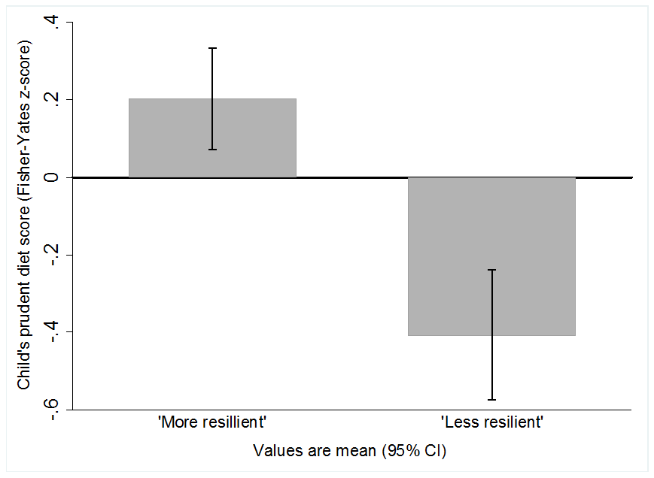
Results 4
Bar graph showing children’s mean prudent diet score according to mothers cluster membership

Slide 12
Results 5
Variable | Coefficient | 95% Confidence intervals | P Value
Mother’s cluster membership | -0.29 | -0.49, -0.08 | 0.006
Mother’s education (6 categories) | 0.15 | 0.08, 0.22 | <0.001
Food insecurity (2 categories) | -0.05 | -0.11, 0.01 | 0.09
Frequency of child sitting at a table to consume meals (4 categories) | 0.17 | 0.05, 0.28 | 0.004
Frequency of child eating meals in front of the television (4 categories) | -0.14 | -0.21, -0.06 | <0.001
Child’s average daily screen-time (hours) | -0.08 | -0.16, -0.003 | 0.04

Slide 13
Summary
Mother’s who are less resilient tend to manage their children’s mealtime environments differently and have children with poorer quality diets than mothers who are more resilient
These factors are more common in women disadvantaged by lower educational attainment
Interventions to improve children’s quality of diet need to support women to manage their children’s eating habits and mealtime environments in a way that makes them feel more in control

Slide 14





Thanks goes to
The women who took part in our surveys and focus groups.
The Southampton Initiative for Health team
Dr Mary Barker, Professor Sian Robinson, Professor Cyrus Cooper, Professor Don Nutbeam
Those who support our work:

